Slide 1
Chinese Landmark & Attraction Recognition
Hao Wu
Project committee members:
Min Chen (Chair)
Dong Si
Yang Peng

Slide 2
Contents
Introduction
Methods
Results
Demo
Conclusions

Slide 3
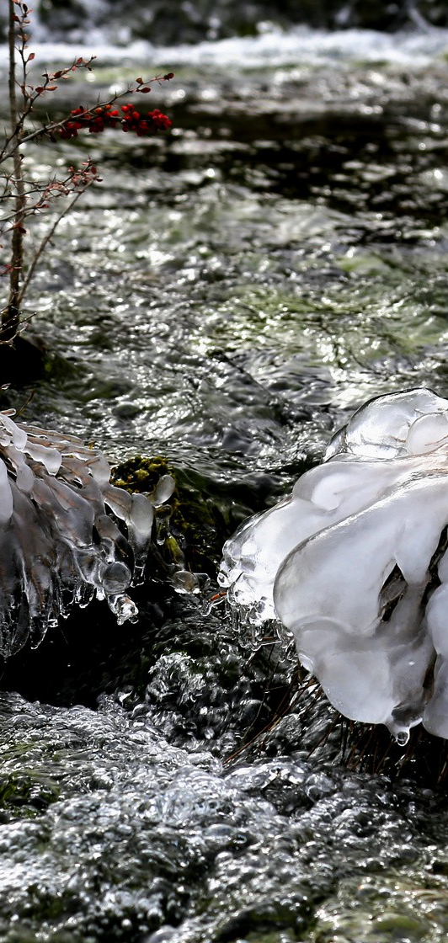
introduction
Problem & Challenges
What has been done so far?
What am I doing?

Slide 4
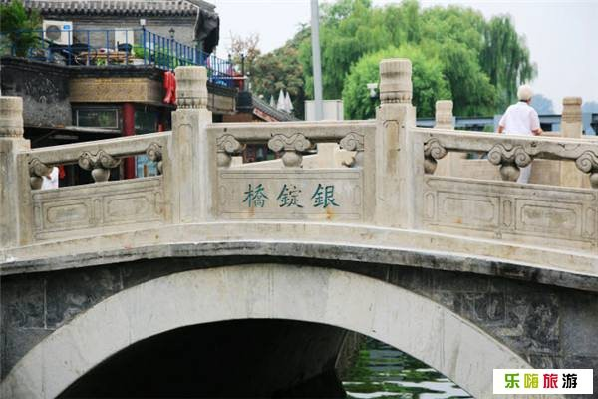
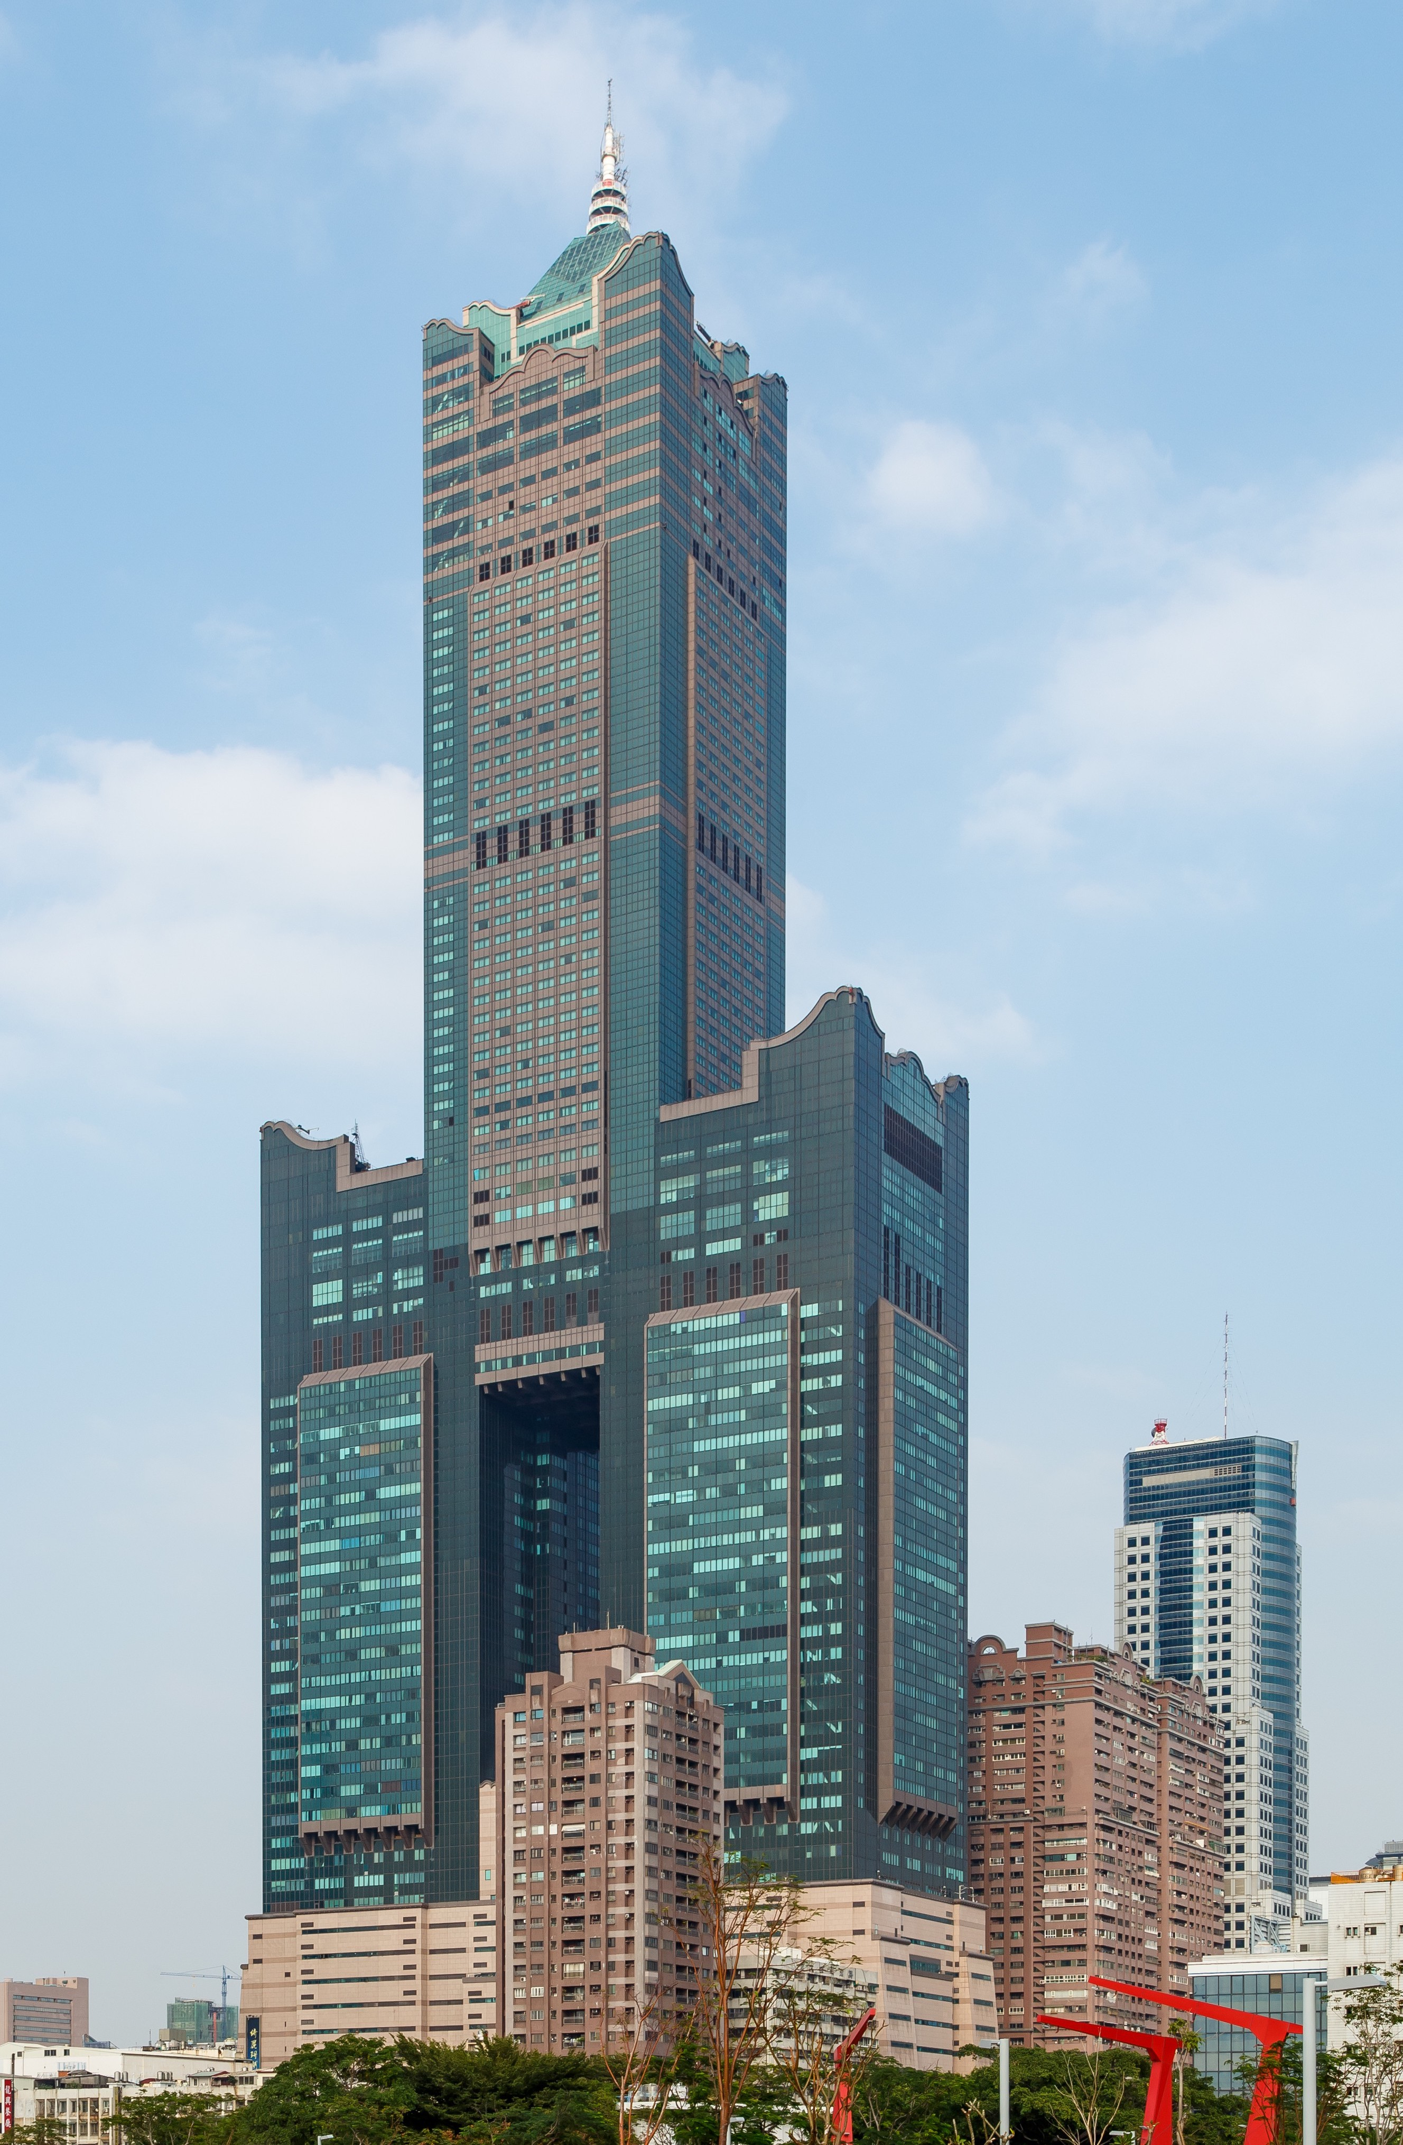
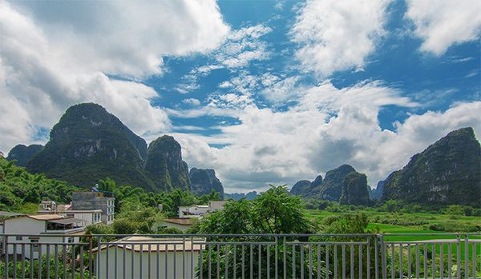
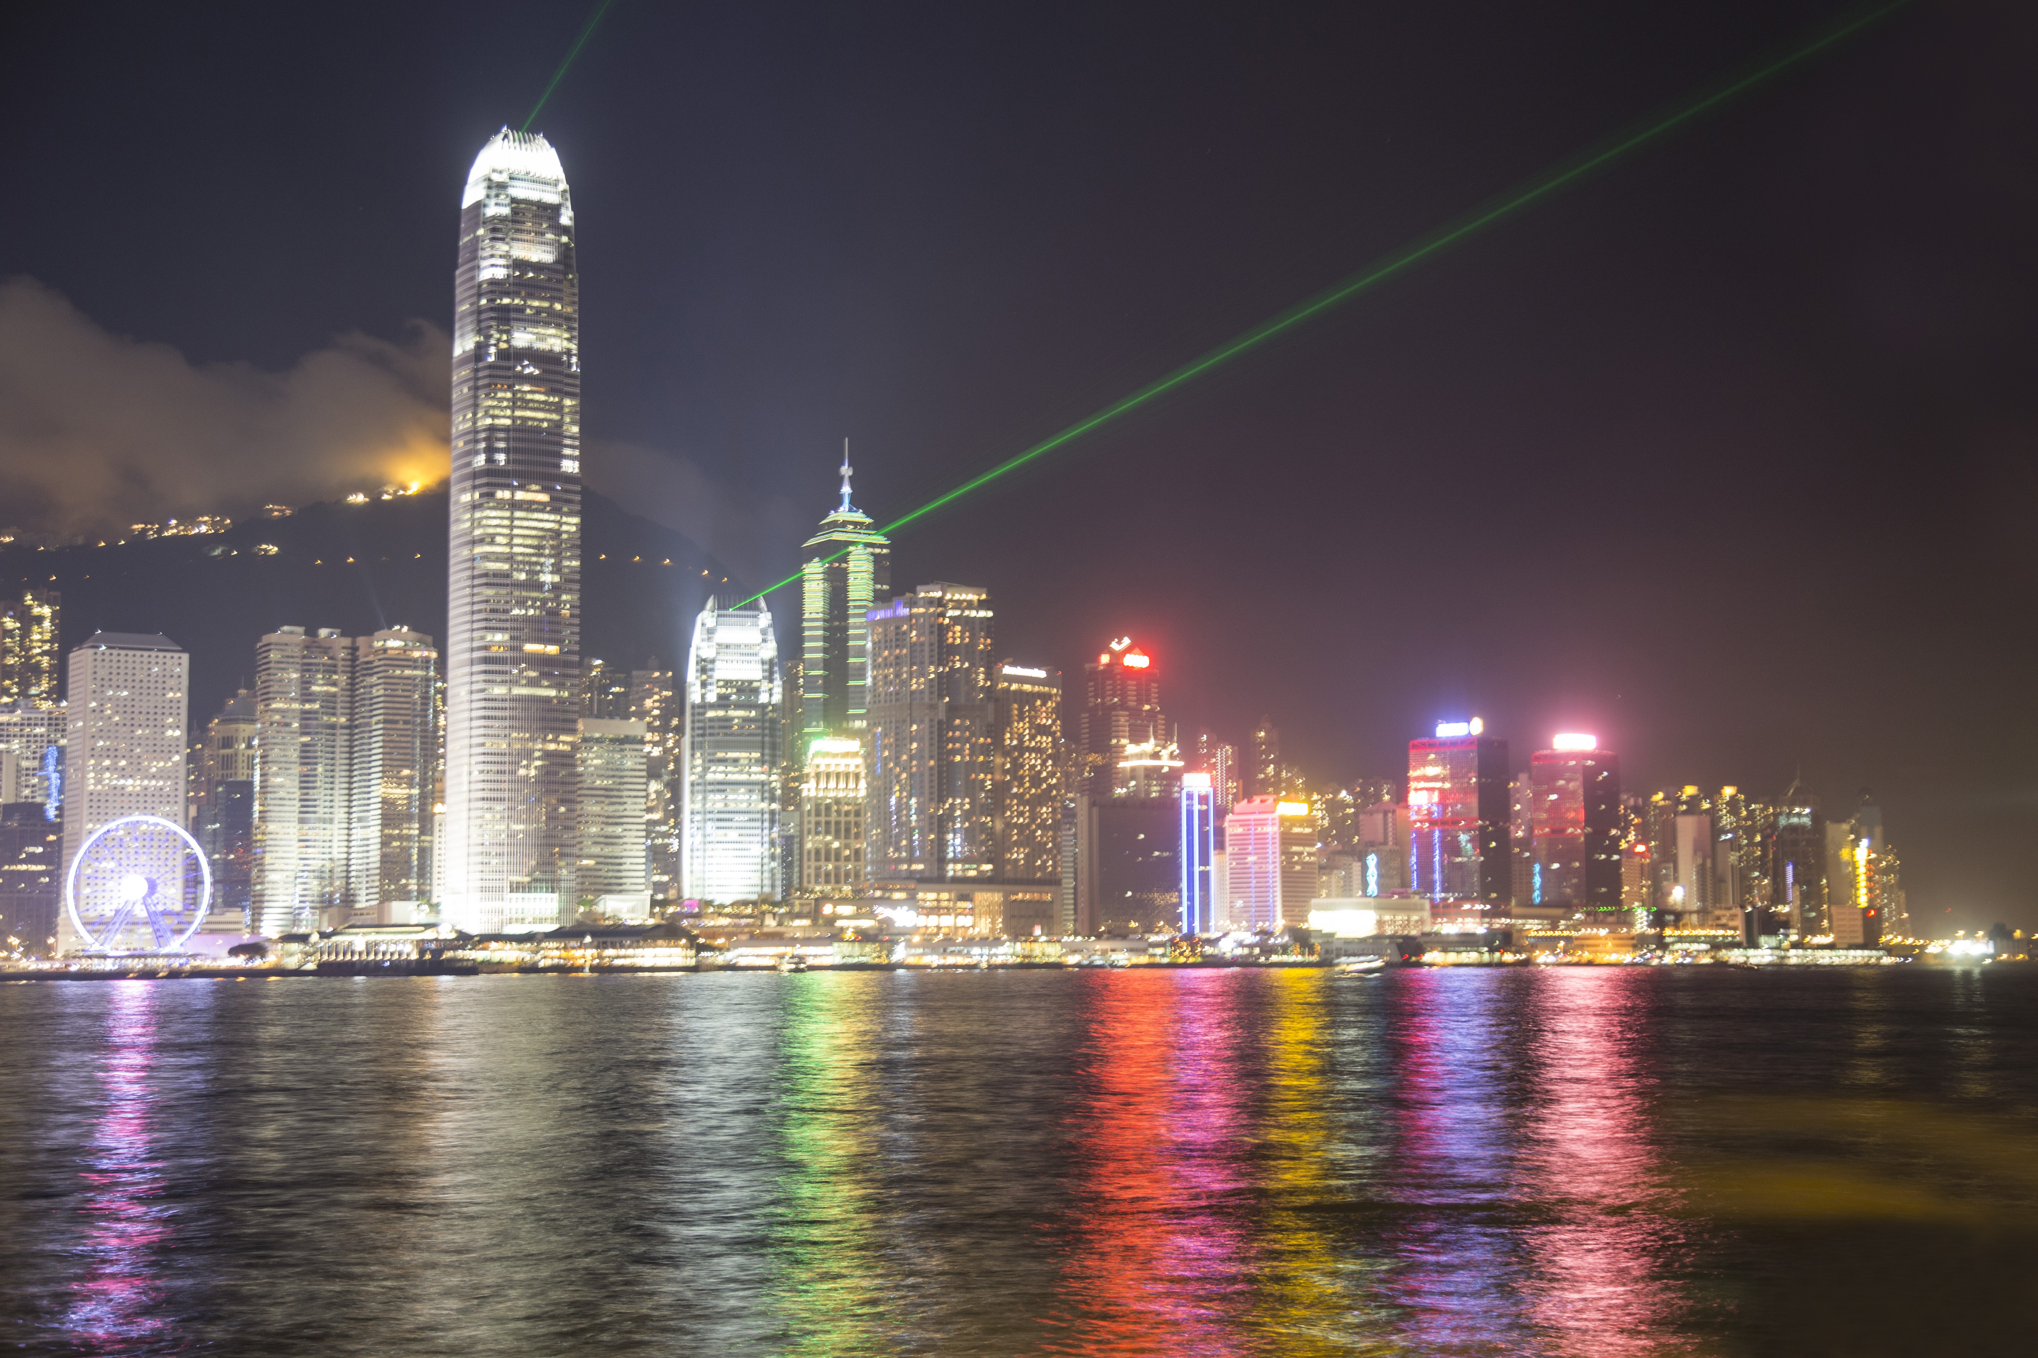
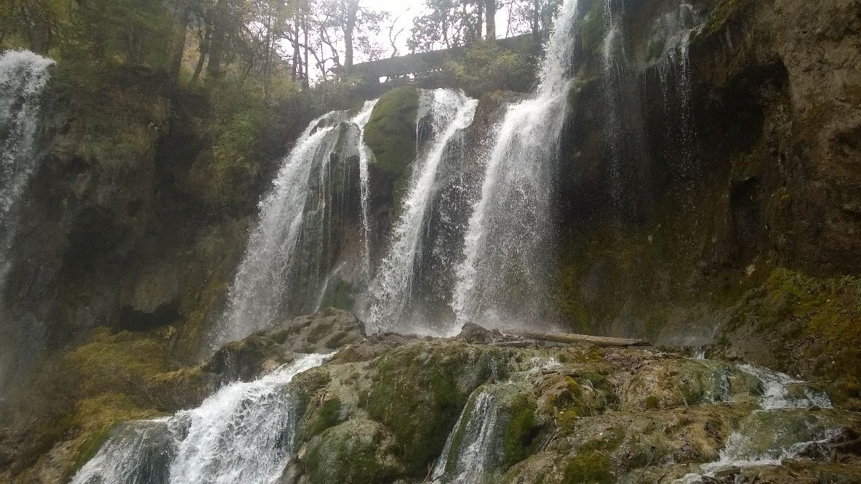
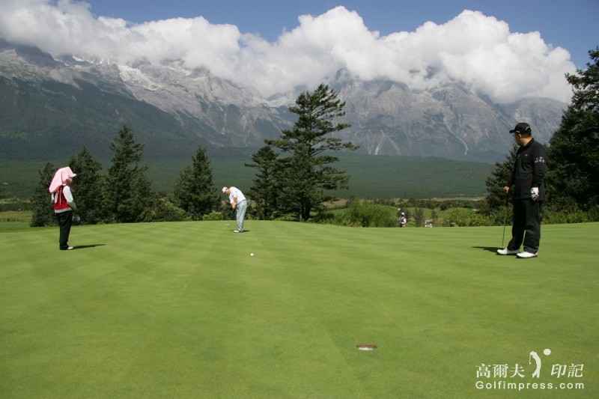
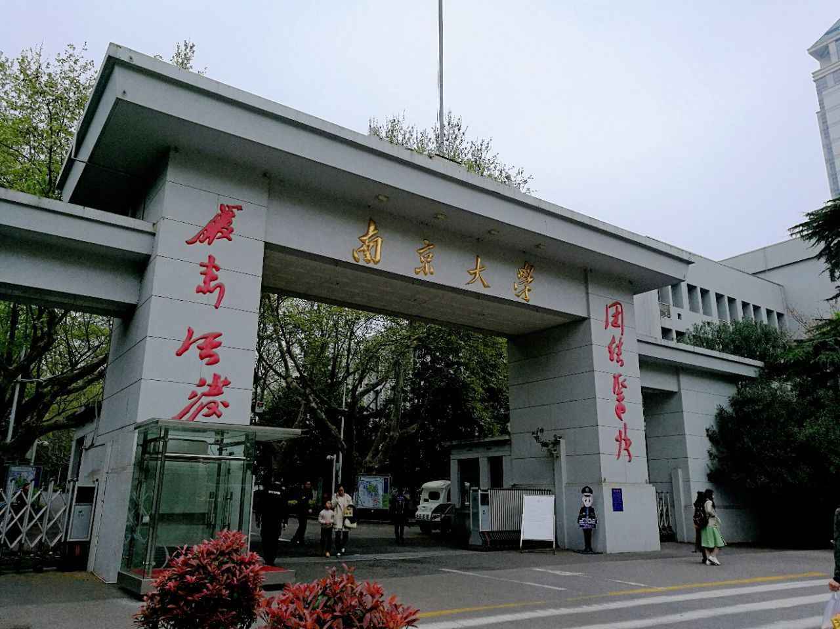
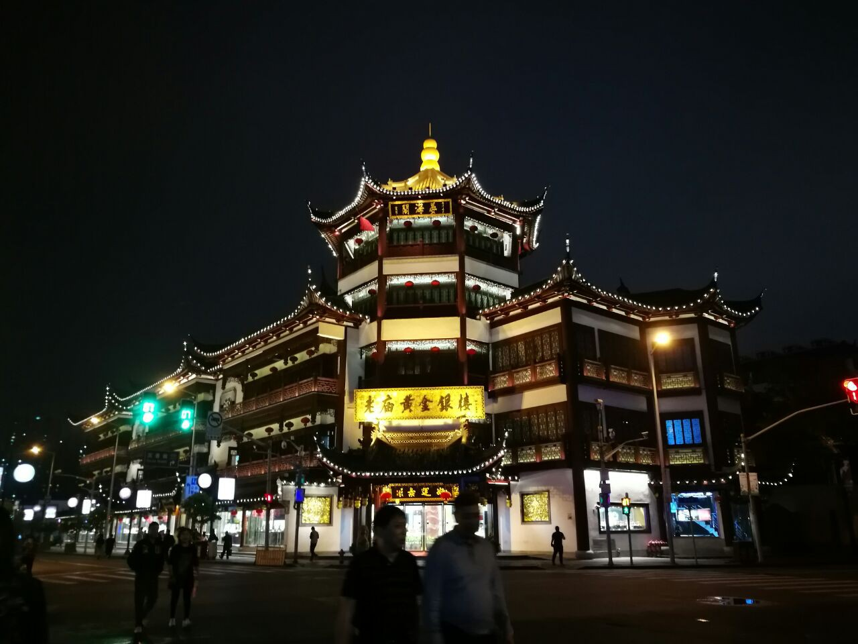
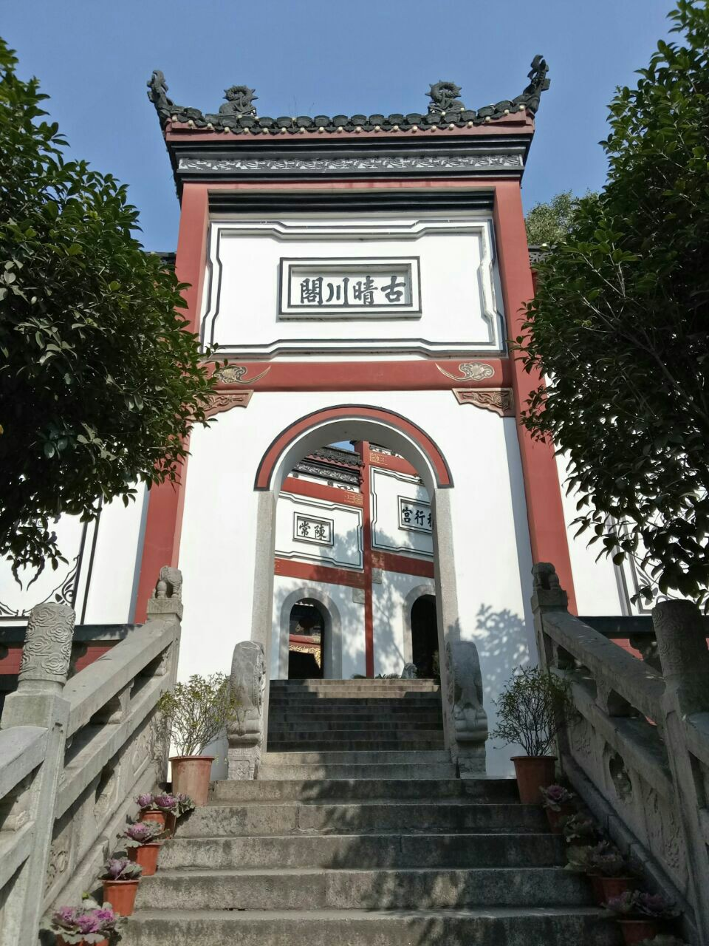
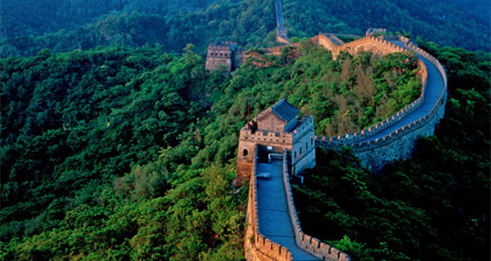
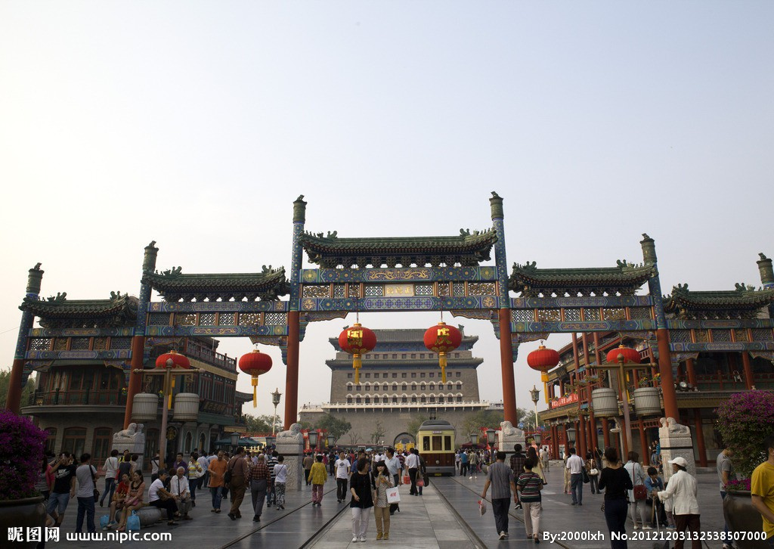
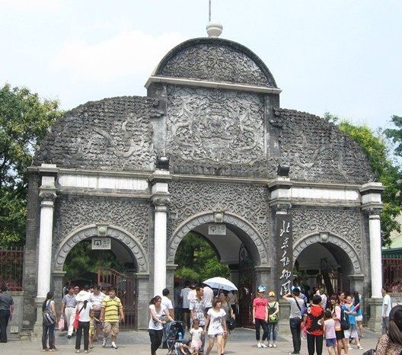
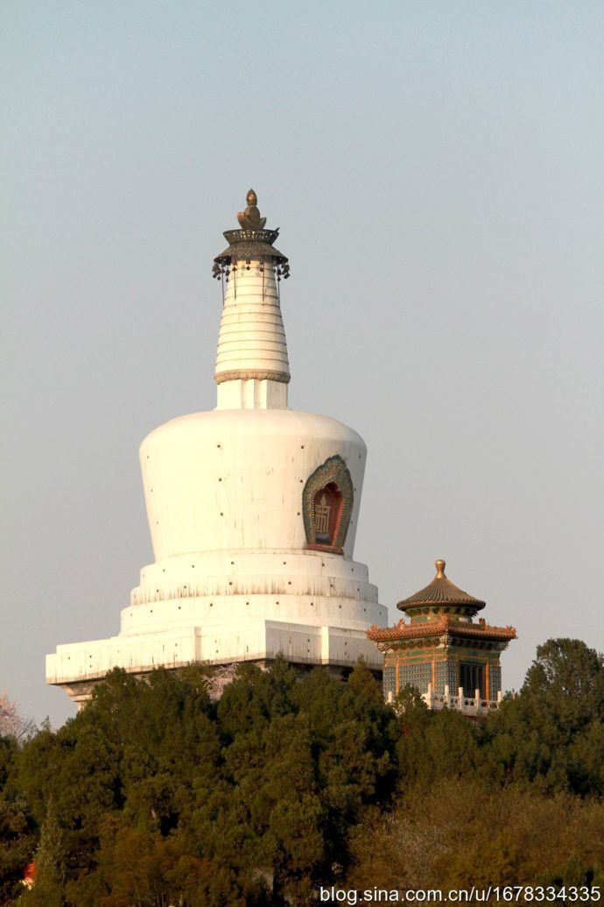
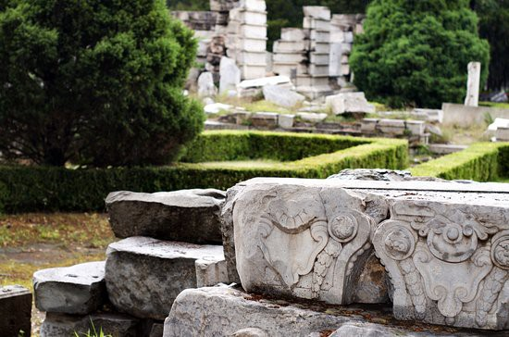
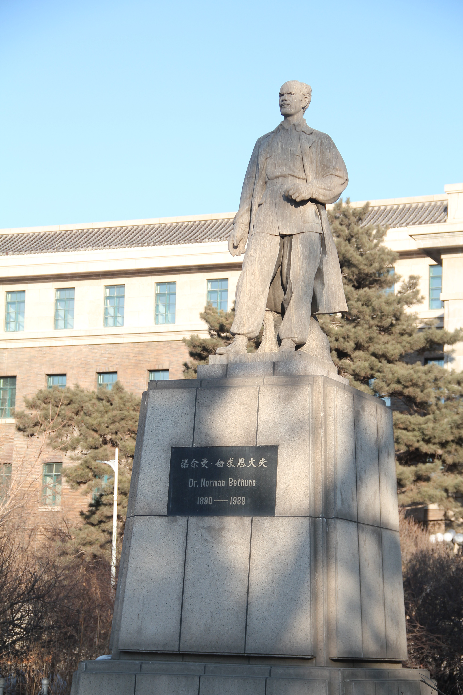
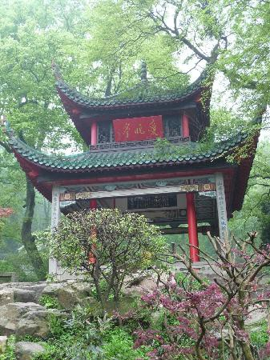
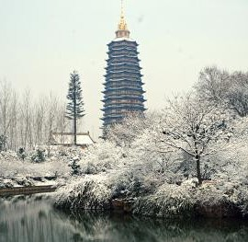
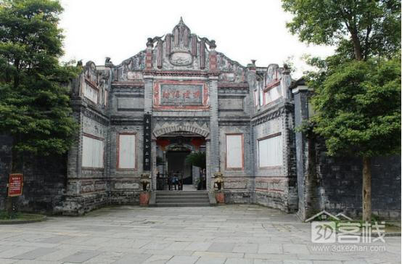
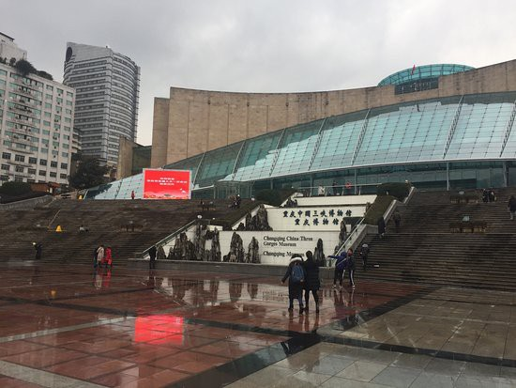
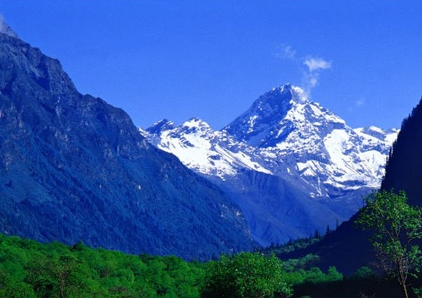
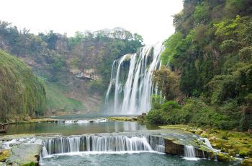
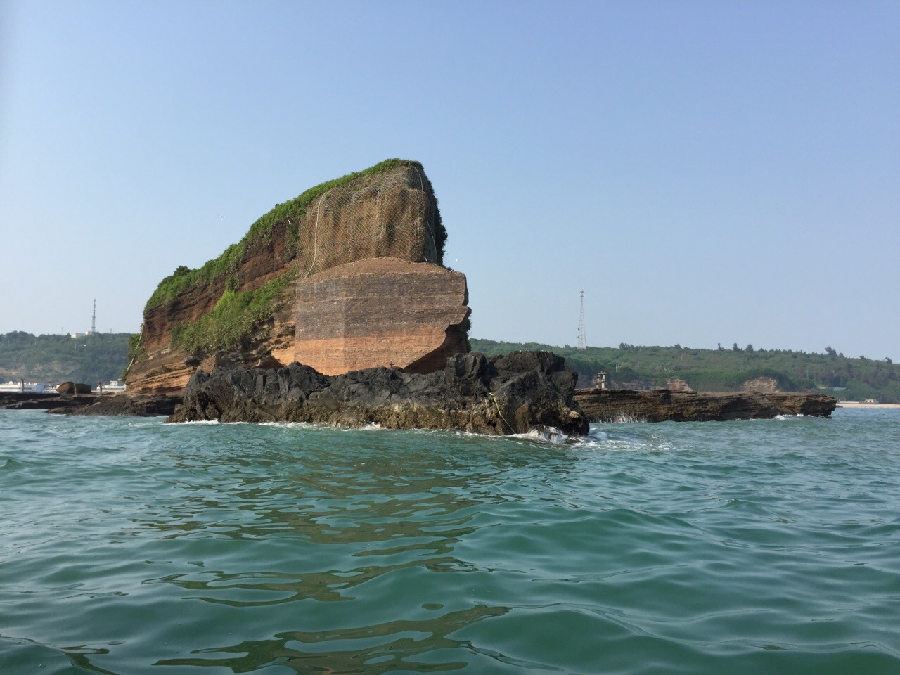
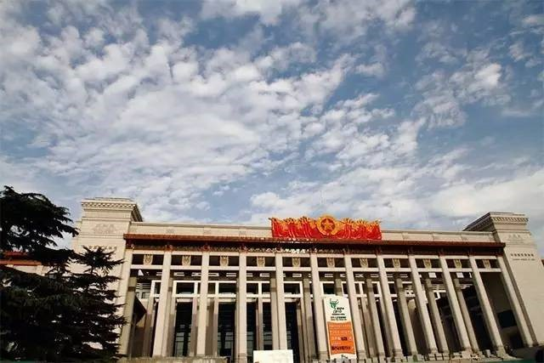
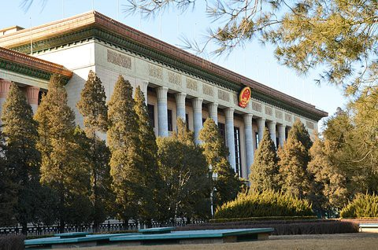
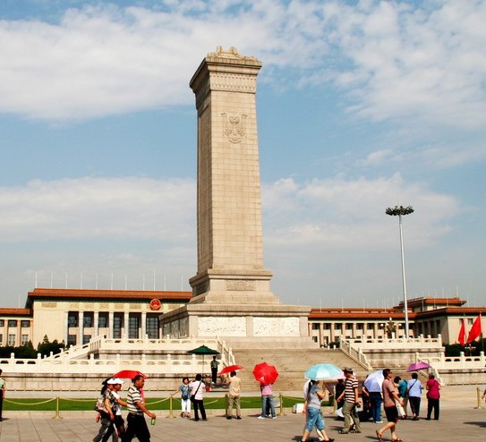
Can you recognize ?
Notes:
Can you recognize all the landmarks in this image? They all located in China. We may recognize popular ones, like Great Wall in this image, or probably Shanghai city in this image. But it is hard for not-so-famous landmarks. Here landmark recognition can help!

Slide 5
Problem & Challenges
What is landmark recognition?
Recognize landmarks directly from image
Tour guide, or help people organize their photos
Why is hard?
No such application.
Not enough data
Not-so-famous landmarks
Non-English Speaking countries
Notes:
What is landmark recognition? It helps people to recognize landmarks directly from image. The user scenarios could be, it works as tour guide when we visit new place, or help us to organize our photos after the trip. Why is hard? There is no such applications. We may use Google Image. But first, it needs internet access, and we also need Google service available. Second, it is not design for landmark recognition purpose, so there is not enough data. Especially for not-so-famous landmarks in non-English speaking countries.

Slide 6
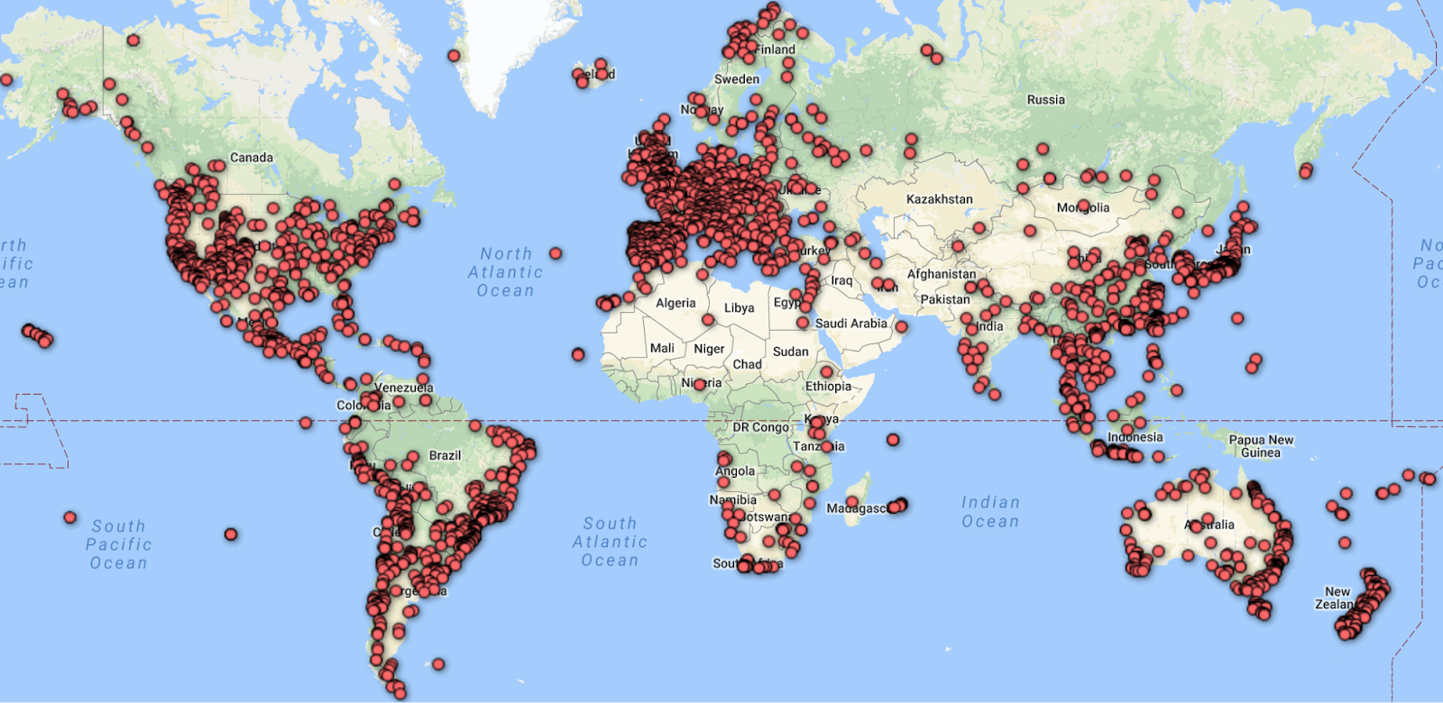
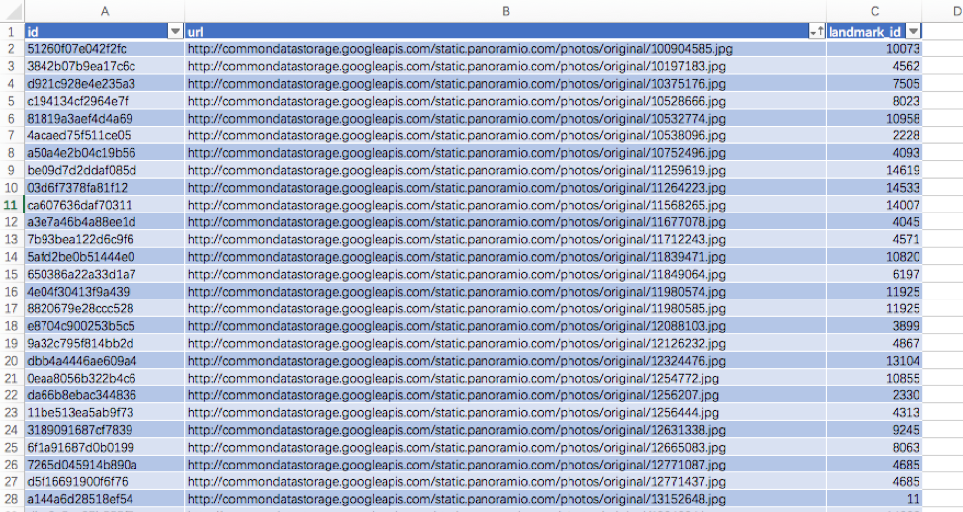
What has been done so far? Dataset
Tour the world (Zheng et al.)
101 landmarks in China
Google-Landmarks (Noh et al.)
Notes:
Related work. Since we talked about data, let’s also started with dataset people have build in this area. These two papers motivate me to do project on Chinese landmark recognition. The first paper build a world wide landmark dataset, China only has 101 landmarks. Based on their work, Google release Google-landmarks, the biggest landmark dataset, from the geolocation distribution of the dataset, we can tell most of the landmarks are located in North America and Europe. The authors attribute the location bias to 1 they use English mainly when they explore data on the Internet. 2 the user community of their data source, such as picasa and panoramio. Most of the users are from North America and Europe. So, we want to build a more comprehensive Chinsed landmark dataset a complement for current work. At first, we think we can take advantage of Google Landmarks, since it is public, we can directly use Chinsed data from it as a start. Unfortunately, here is a screenshot of the dataset, for each instance, they only provide an Image ID, url and landmark ID. It takes time and effort to retrieval Chinsed landmark information. Therefore, we will build Chinese landmark dataset from scratch.

Slide 7
What has been done so far? Algorithms
Deep learning
Convolutional Neural Network (CNN)
Transfer learning with ImageNet
Notes:
There is no Chinese landmark dataset ready to use, how about the algorithms? Luckily, deep learning and especially the use of cnn have improved the stare of the art in computer vision. Recently, cnn architectures get the best results in most public visual recognition challenges. Another advantage of using CNN is we can transfer the generic extractor learned form large dataset, such as imageNet, which is the largest image dataset, to our own task of interest. There are researches show the outstanding performance when apply transfer learning to different object classification task. In our project, we use CNN and transfer learning for different purpose. We will talk about detail later.

Slide 8
What am I doing?
Chinese landmark & attraction dataset
Data pre-processing: Data collection, Data cleaning
Data preparation: Image cropping, Data augmentation
Chinese landmark recognition model
Algorithms for model training & evaluation
iOS application

Slide 9
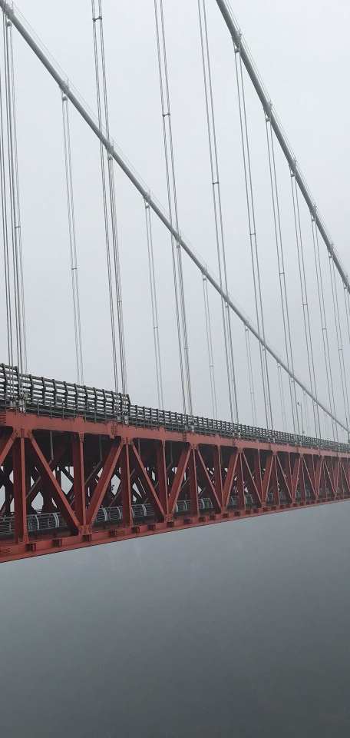
Methods
Project Workflow
APIs Review
Dataset
Model
iOS Application
Notes:
This section covers methods and detail about my project. Let’s start with work flow.

Slide 10
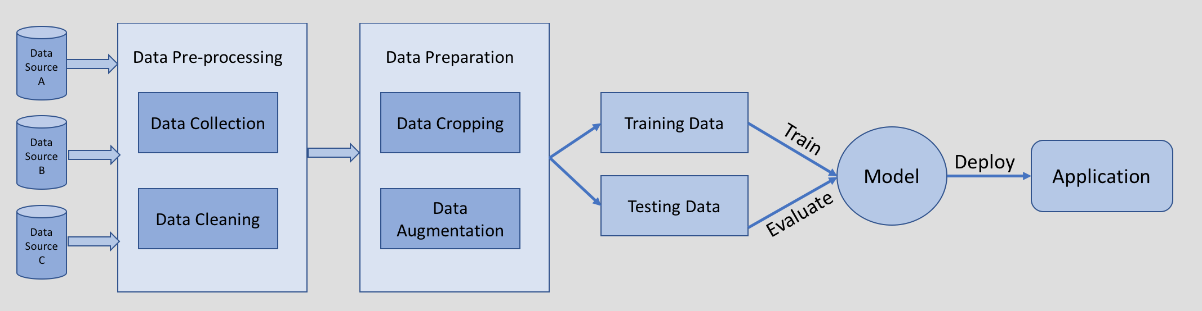
Project Workflow

Slide 11
Landmark Recognition Options
 | UI | Flexibility | Cost
APIs [1,2] | Yes | Low – fixed model | Middle – API call
ML platform[3,4] | Yes | Middle – fixed algorithm | High – upload, store, train, predict
Library[5,6] | No | High - customize | Low – GPU
[1]Google Cloud Vision [2]Microsoft Computer Vision
[3]Google Cloud AutoML [4]Microsoft Custom Vision [5]Tensorflow [6] Keras
Notes:
Before we dive into detail, I want to let you know other options for landmark recognition.

Slide 12
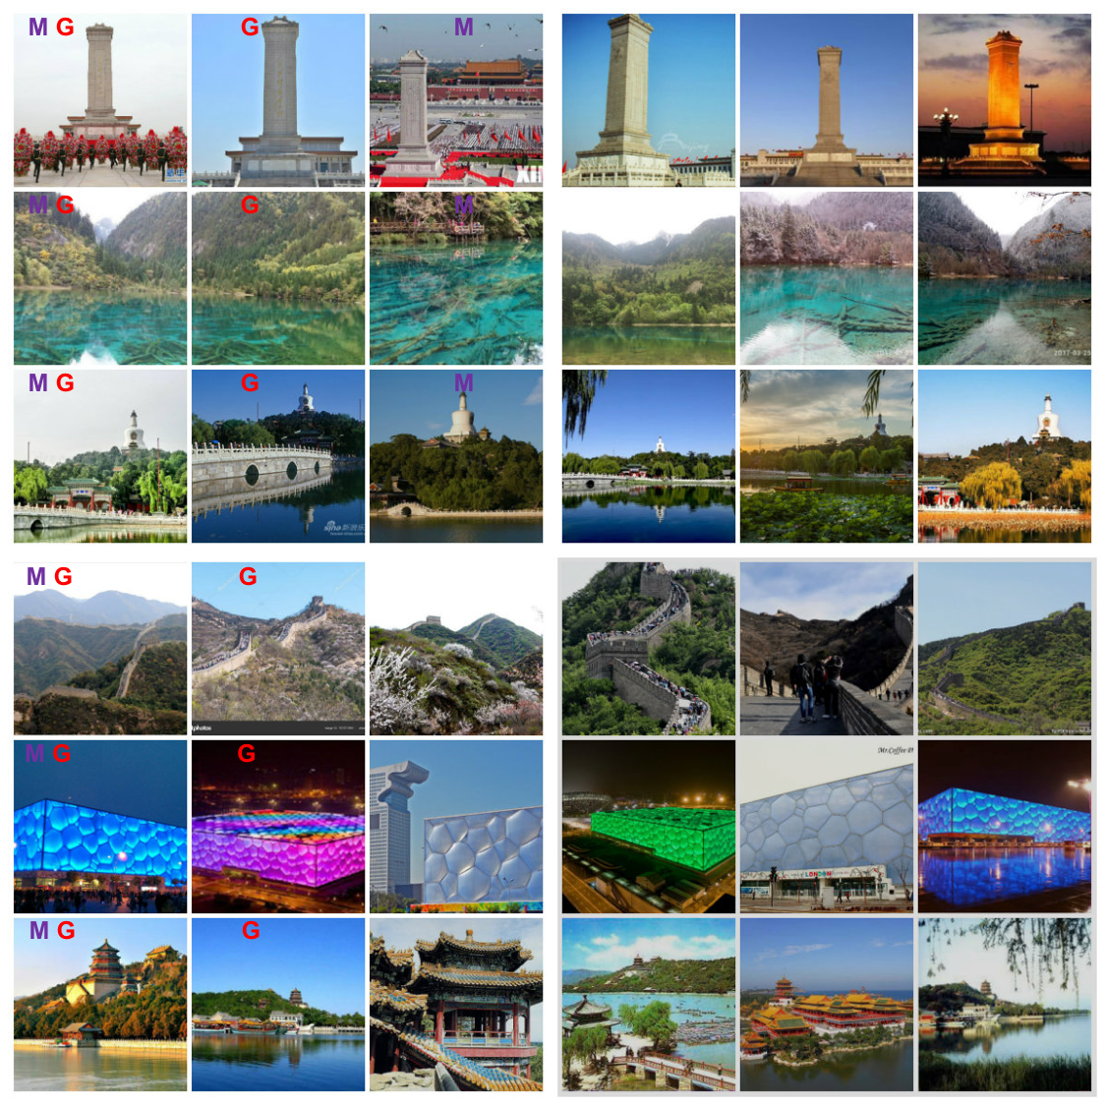
API Review Results
 | Accuracy
Microsoft | 48/406(11.8%)
Google | 145/406(35.7%)
Notes:
We test the first option, the commercial API with Chinese landmark images. Here are sample images and according results. Images in each row contain the same landmark. And the tag on upper left means whether it is recognized by Microsoft, or Google. Images with no tag means both model fail to recognize. We can tell, both models fail to recognize the known landmark with some degree of variance. The testing accuracy are quite low for 406 Chinese landmark images. All these indicate the lack of Chinese landmark dataset in their model.

Slide 13
Chinese Landmark & Attraction Dataset
Data source
Ctrip
TripAdvisor
Search engine
Notes:
It is time to build our own Chinese landmark dataset. Form where we get the data? We explored a couple if websites. Ctrip, which is currently the largest online travel agency in China. TripAdcisor, similar, but in the US. Both of them are free to users, and users provide contents such as rankings, reviews, text and image comments for each landmark on these website. From these two websites, we can get a landmark list by popularity, and also we want to web scraping the images for our dataset. We also use search engines such as Google, Baidu and Google Image complete our landmark list and image dataset.

Slide 14
Data Pre-processing
Data collection
Web scraping with Python and Node.js
Transfer the unstructured data (HTML) to structured data (CSV)
Example
Tripadvisor
~500K images for 3,359 landmarks
Notes:
Next, we can do data collection by using web scraping. For different websites, we need different libraries. We use python and Node.js in our project. The key point for web scraping is transfer the unstructured data (HTML) to structured data. I will use Tripadvisor for example. Finally we got around 500 k images for more than 3K landmarks. From the image gallery we just saw on tripadvisor, we can tell there are lots of noise in the raw data. We need to do some data cleaning job.

Slide 15
Data Pre-processing
Data cleaning
Group similar images
Keep correct image groups
Discard others
Notes:
For data cleaning, we want to first, clustering the images by its content, group similar images. Then we keep correct image groups and discard others. The first step is done by clustering results automatically. While the rest involve human’s decision. I will use examples to explain later

Slide 16
Data Cleaning: Image Clustering
Unsupervised machine learning
Convolutional neural network: VGG19
Transfer learning: pretrained with ImageNet
Fixed feature extractor: fingerprint for image
Hierarchical clustering
A set of nested clusters that are organized as a tree
Similarity index
Notes:
How we do for the first step? We apply image clustering. Clustering is one common task for unsupervised machine learning. We use cnn plus transfer learning here. We take a cnn architecture, VGG19, pretrained on ImageNet, remove the last layer of the model, treat the rest of the model as a fixed feature extractor to get fingerprint for each image. Then we can hierarchical clustering the images by the similarity of the fingerprints.

Slide 17
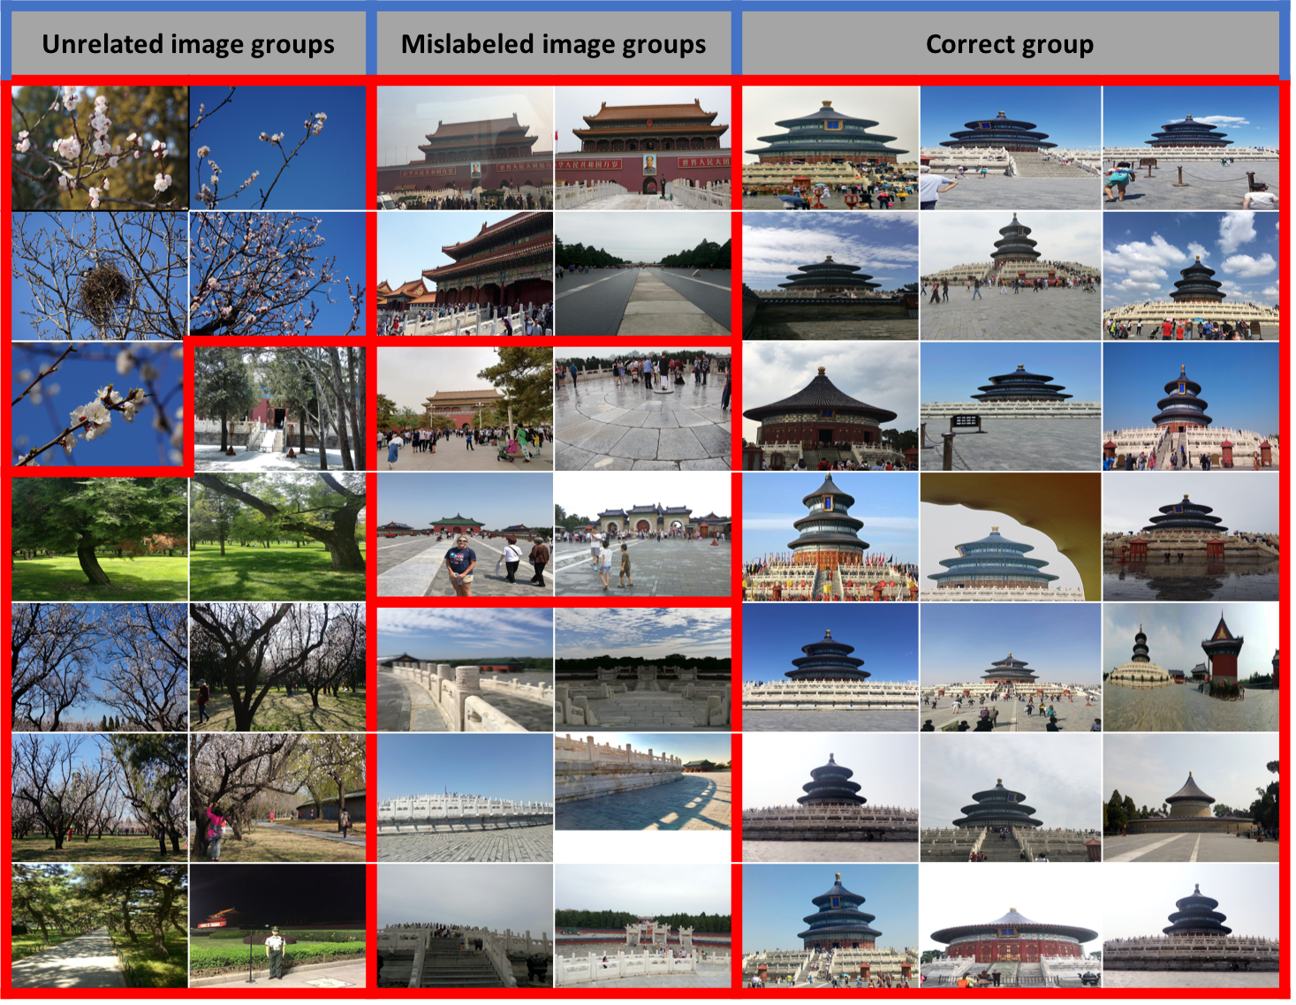
Data Cleaning: Image Clustering
Before:
~500K images for 3,359 landmarks
After:
~40k images for 1,059 landmarks
Notes:
Here is the example. This is the clustering groups for one landmark. Images in same red box belong to same group. Only the group on the right are what we need. Other groups are either unrelated to the landmark or mislabeled. Here comes to the human decision. We need to decide which group to keep. I thought about doing the whole process automatically by keeping the group with most images. But it did not work nicely. Because, first, the largest group may contain plants or person instead of the landmarks. Second, there are cases that some small groups contains the landmark, but just the images are taken form different point of view, or under different weather conditions. For these case, we want to keep these groups. So In order to get relevant images as more as possible, there are some manual work involved, we write help functions to iterate all the groups and make decisions based on the contents of the group. After image clustering, our dataset shrinked to around 40k images, for 1k landmarks. However, image clustering is not enough, there are images contain landmarks at various scales with complex background. We need to prepare the data so that the landmark information is best exposed to deep learning model. First thing we do is image cropping.

Slide 18
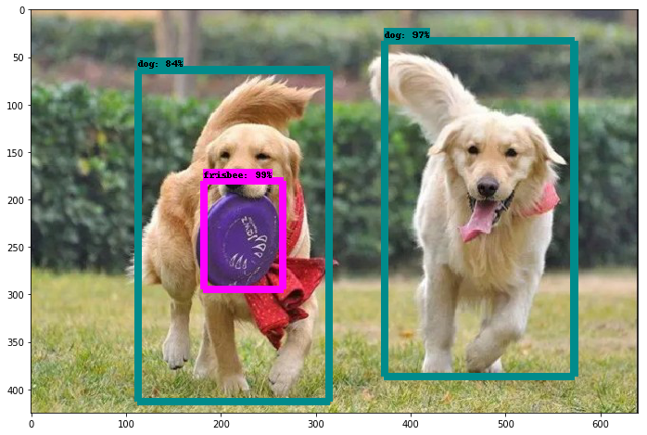
Data Preparation: Image Cropping
Object detection?
Detect instances from known classes
Tensorflow API
CNN based
Object detection
Notes:
We tired two ways to do image cropping. Actually we use the second one covered in following slides. But the first idea naturally come to my mind is object detection. What is object detection? Like this image shows, it detect instance from known classes. Ideally, we want to use such an API to detect mountains, buildings person in its bounding boxes, and we just crop what we want.

Slide 19
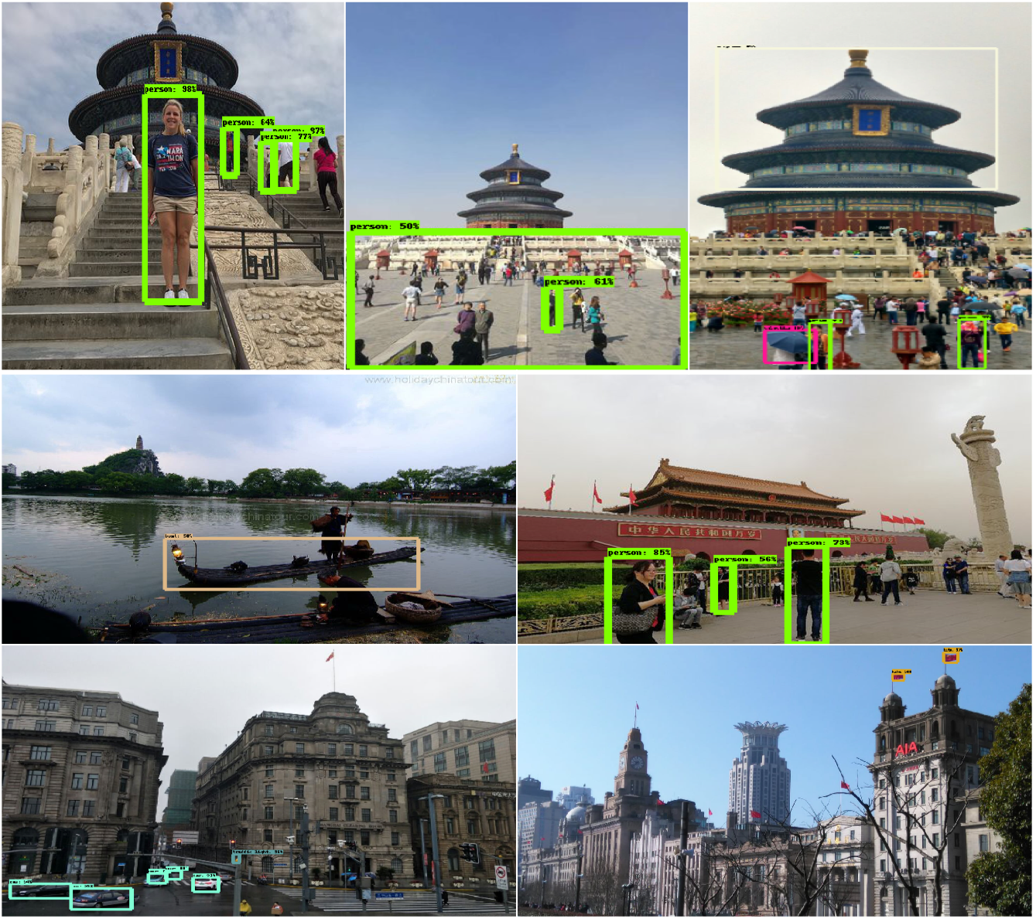
Image Cropping: Object Detection? No
Notes:
Here is the result when we apply the API offered by Google. Their model does not fit our dataset. It is good at recognizing person, boat, cars and even flags, but it ignore the temples, mountains, and buildings. The data they used to train their model does not have enough landmark related categories. We certainly can train a model with new date, but we have better options.

Slide 20
Data Preparation: Image Cropping
Object retrieval?
Detects similar local features between images
DEep Local Feature (DELF)
Also CNN based
Optimized for landmark recognition
Notes:
Object retrieval. It detects similar local feature between images. When Google release Google-Landmarks, they also release one model they used. It is called Deep local Feature, DELF for short. It is also CNN based, and optimized for landmark recognition. It works good for our purpose.

Slide 21
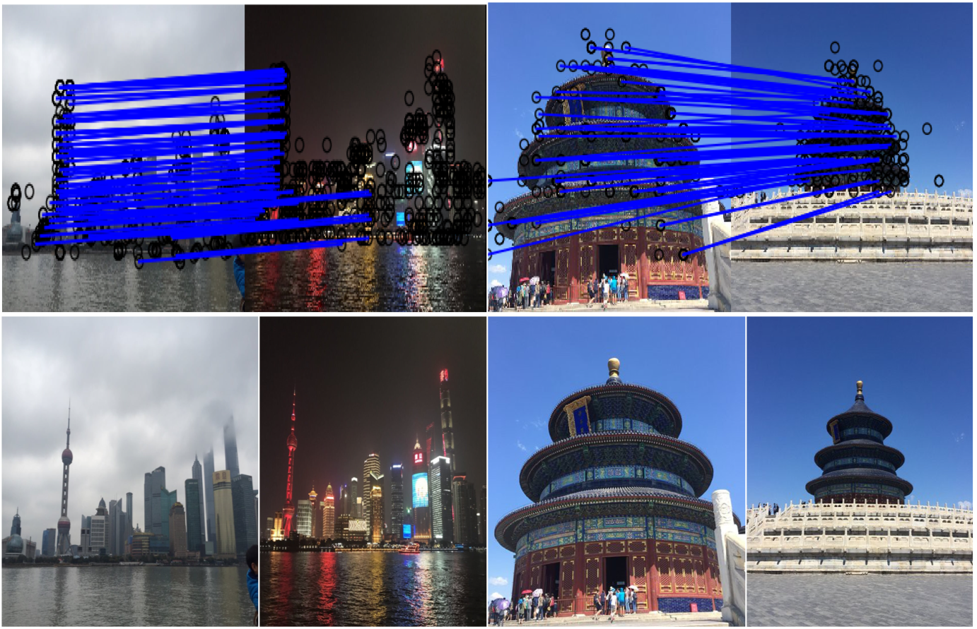
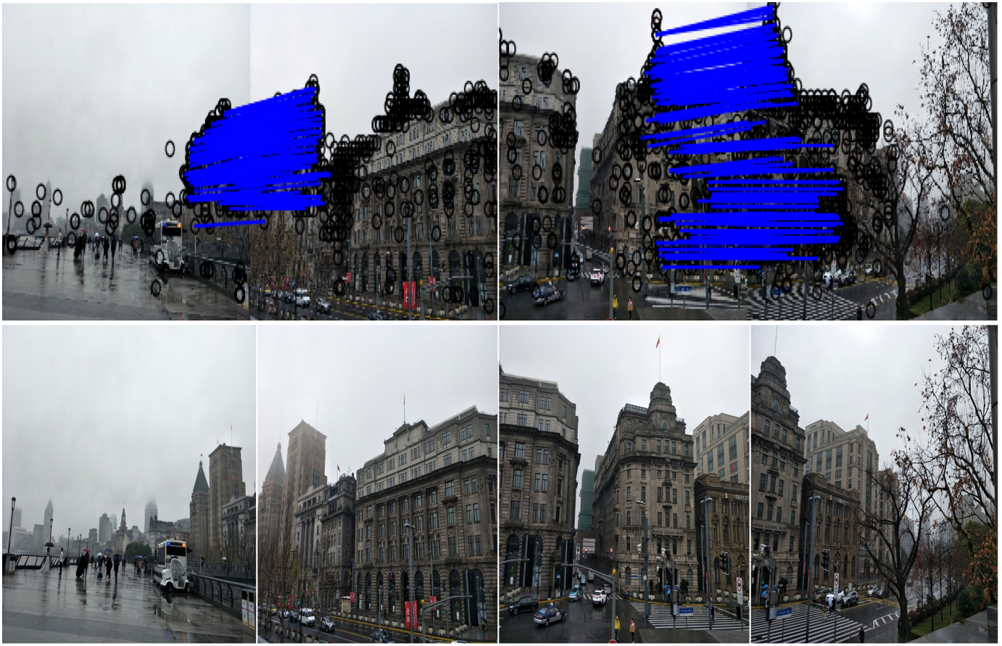
Image Cropping: Object Retrieval? Yes
Visualization of feature correspondences between images using DELF
Notes:
Here is the example. There are four groups of images. Each group contain two images, which have the same landmark. The lower parts are the original images. By applying DELF, we can precisely find the same landmark. The blue lines indicate the similar local features the landmark have between different images. We can then me a bounding box according to the location of the local features Delf find, and then crop the landmark out of the image.

Slide 22
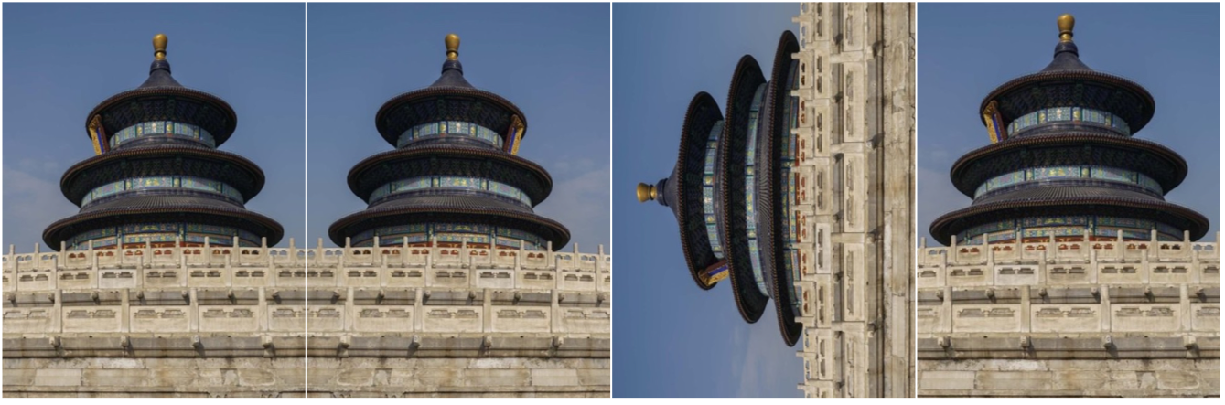
Data Preparation: Data Augmentation
One way to increase the amount of relevant data in our dataset
Flip, Rotate, Scale
Online augmentation: transformations are applied in real time in batches
Notes:
Another technique we use is data augmentation. Like the name suggests, we do tricks to increase the amount of relevant data in our dataset. Common ways of image augmentation is flip, rotate and scale the image. The library we used keras offers function to do online augmentation, the transformation are applied in real time in batches. This process can be accelerated on the GPU.

Slide 23
Chinese Landmark Recognition Model
Model
Convolutional Neural Network: ResNet50, VGG19
Transfer Learning
Pretrained on ImageNet
Replace the last layer with SoftMax Classifier
Train with our dataset
Notes:
After the dataset is ready, we can consider about the model. We also use CNN and transfer learning here. This time we choose two cnn architectures Resnet and VGG to compare. Both models are pretrained with ImageNet. Different from image clustering, this time, we replace the last layer with a softmax classifer, this layer will output a separate probability for each landmark category. Then we can train with our dataset on a GPU.

Slide 24

Chinese Landmark Recognition Model
Training & Evaluation
Split the data into training and validating sets
Evaluation
Underfitting & overfitting
Fine-tune
$$Accuracy= \frac{Number of Correct predictions}{Total number of predictions made}$$
Notes:
It is the time to train the model. We need to split the data into training and validating sets. We use Accuracy, It is the same metric we used when we test the commercial APIs. We tried different algorithms with different subset of the dataset. And during these process, We encountered underfitting and overfitting issues. For underfitting, the model does not learn enough information from the data, and it performs bad on both training and validating set. For overfitting, the model learns to hard from the training set, even the noise. Then performs terrible on new data. To solve such issues, we may need fine tune our model by retouch the dataset, modify the hyper parameters, or use different algorithms. More detail will be covered on Results.

Slide 25
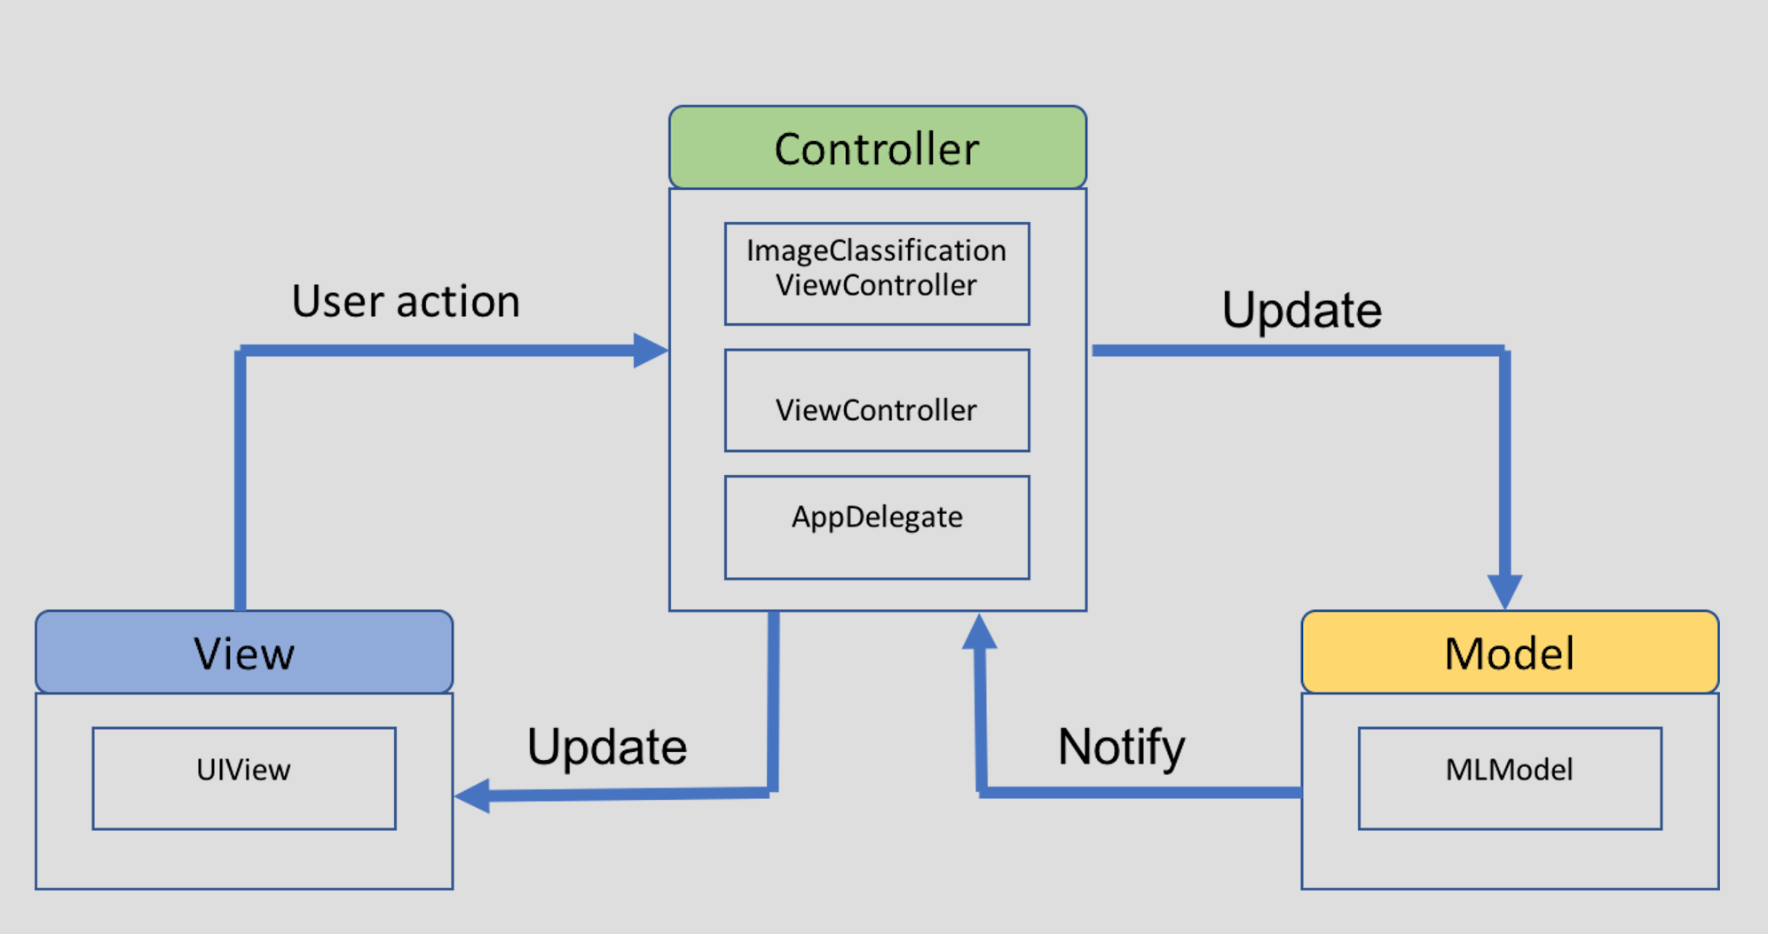
iOS Application: CoreMLTools
Mobile application MVC architecture
Notes:
There is no such a mobile application to do landmark recognition. That’s another motivation of my project. We use open source library keras to generate the machine learning model. Then Apple provide a library called coreMLtools, to convert such a model to a format that can be used for iOS application. For this application, we adopt MVC architecture, our app has a simple user interface, it allows user to take a photo by camera or choose a photo from the device, and the machine learning model will return the classification results automatically. I will do demo later.

Slide 26
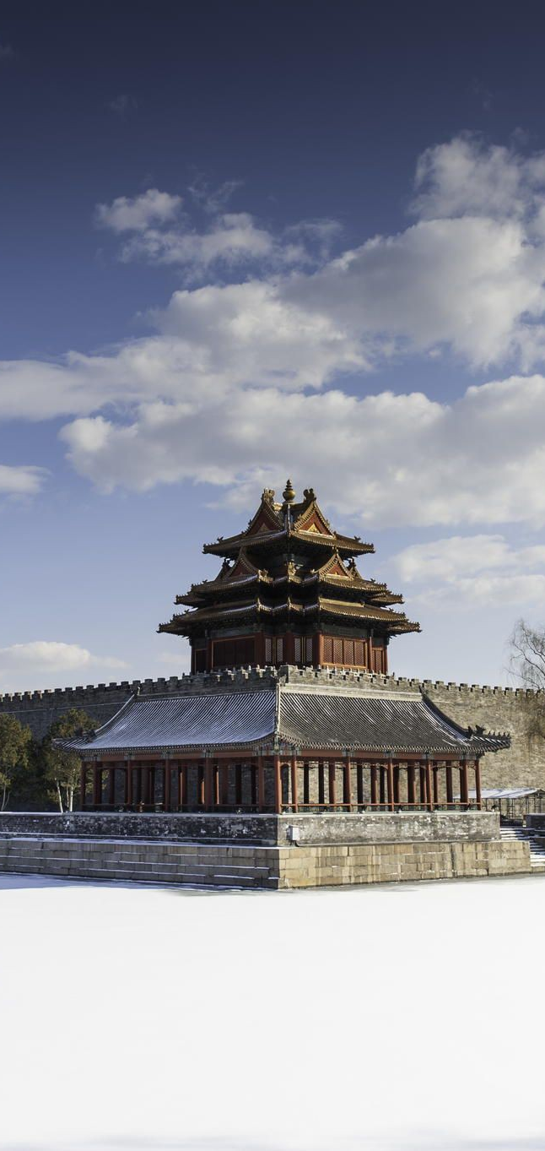
Results
Datasets
Model Validation Results
Notes:
Finally, we can talk about the results.

Slide 27
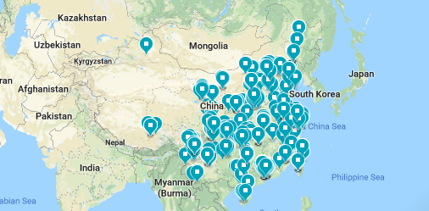
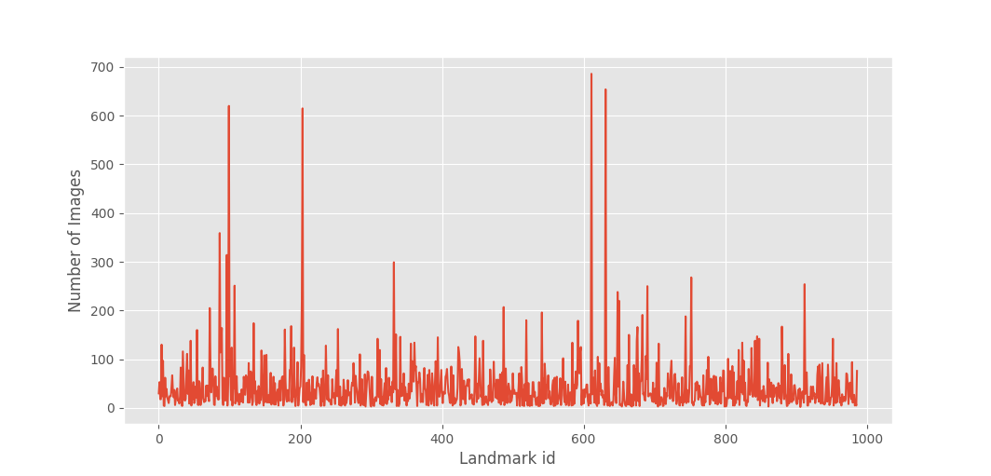
Results: Datasets
42,548 images for 987 unique landmarks
Geographic distribution of Chinese landmark & attraction dataset
Landmark images distribution
Notes:
For the dataset, we got around 4k images for around 1k landmarks. Here is the geolocation distribution of our dataset. Also, here is the images distribution. The x value is the landmark ID from 1 to 987, the y values is the number of images for this landmark. we can tell we have unbalanced data, around 6 landmarks contains more than 300 images, while the average image for each landmark is around 40.

Slide 28
Results: Model Training & Evaluation
Categories | Images/ Category | ResNet50 |  | VGG19
 |  | Training% | Validating% | Training% | Validating%
1059 | 2-686 | 66.97 | 22.26 | 47.58 | 36.64
987 | 2-686 | 78.17 | 27.42 | 57.44 | 50.17
981 | 2-299 | 72.14 | 32.33 | 59.65 | 49.17
771 | 10-250 | 76.17 | 33.18 | 63.09 | 55.69
207 | 60-200 | 85.14 | 47.38 | 74.33 | 70.64
Notes:
We use two cnn presentations to compare the results. We use different subsets of our dataset to deploy the model. For example, the first row is the dataset before we apply image cropping. And the second row it the dataset after we crop the images. The third row, we remove the 6 dominant landmarks which contain more than 300 images. The last two rows, we remove the landmarks which contain less images. From the accuracy, we can tell, first the resnet has overfitting issue, it yields higher training accuracy with lower validating accuracy. VGG is more reasonable. But for VGG, the uncropped dataset has underfitting issue, since the data contains landmark with the noise. After we retouch the dataset by cropping the images, we get a 15% performance improvement. For Resnet, by compare the results from row two and three,, the remove of dominant data improve the overfitting issue a little bit. The difference between training and validating is smaller. The last we find is as the less categories the algorithm need to classify, the more accurate it will perform. Which is make sense. All is about data, as long as we have enough data, we can teach the machine to learn more, but with limited data, we can not ask too much. For deploy the application, we choose the last model, we made trade off between the numbers we want to classify and the accuracy we get.

Slide 29
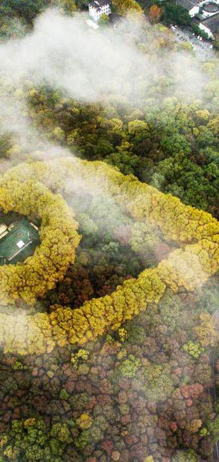
DEMO

Slide 30
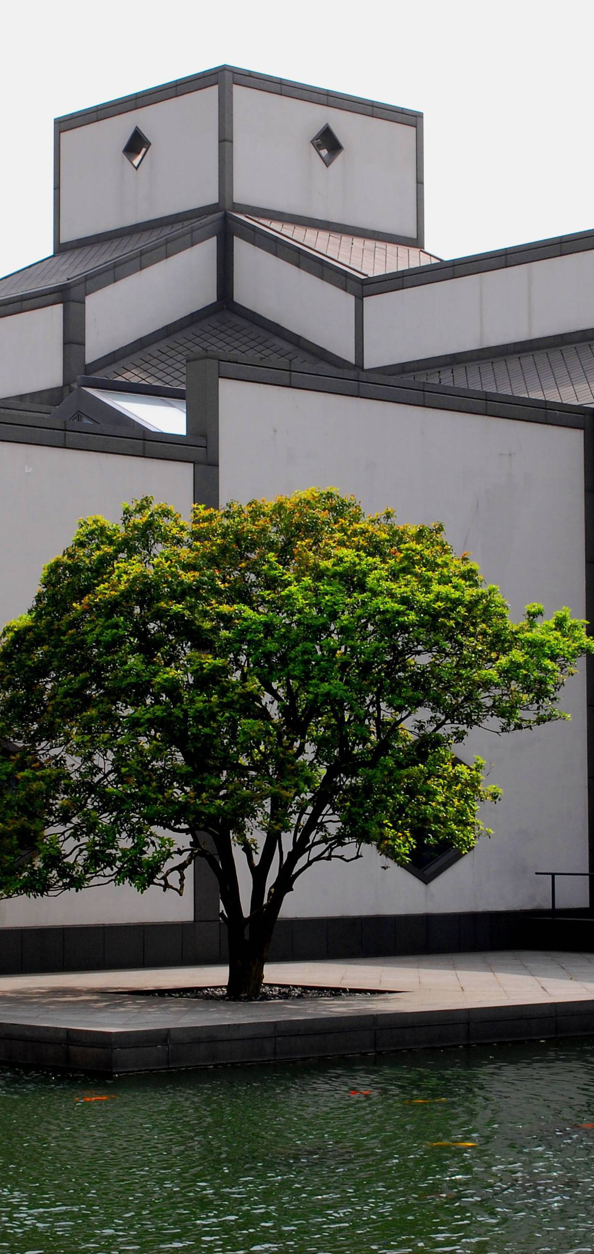
conclusions
Conclusions
Limitations
Future work
Takeaways and difficulties

Slide 31
Conclusions
Experience the workflow of machine learning process
Combination of methods
Chinese landmark & attraction dataset
Notes:
We combine different methods to do this project and we hope this image dataset can also benefits other research purpose.

Slide 32
Limitations
Landmark classification: depends on the data
False positives
Efficiency
Notes:
The more I learned about machine learning, the more limitations I know about my project. For classification problem, the performance really depends on data. For the same reason, we have false positives for our model. Another limitation is efficiency, even we use transfer learning to help us, using CNN architectures takes time, not only the model deploying, but also the image clustering the image cropping. We only use GPU to train our model, but if we also use GPU for clustering and cropping, it would save us some time.

Slide 33
Future work
Dataset
More categories & more images
Different layers of annotation
Model
Algorithm: k-fold cross validation for overfitting issue
Advanced data augmentation techniques
Application
Other information
Notes:
We want to keep updating the dataset by adding more categories and images. We can also add different layers of annotation. Such as bounding boxes, and bounding segmentation for each landmark in the image. Second, there are possible methods to improve the algorithm performance. For example, apply k-fold cross-validation on the Resnet model to overcome the overfitting issue. Or apply advanced data augmentation techniques. For example, there are also machine learning based libraries can transform images from one domain to another. By using it, we can transform images of summer sceneries to winter sceneries, which can make our model more robust. Third, we can make the application more useful, by returning more information to the users. For example, the history, the builder information, even we can further integrate it with some recommendation system for nearby hotels or restaurants.

Slide 34
Takeaways and Difficulties
Takeaways
The workflow of machine learning project
Work with Machine learning libraries & GPU
iOS application
Difficulties
The dataset takes longer time
CNN architectures

Slide 35
Reference
Zheng, Yan-Tao, et al. "Tour the world: building a web-scale landmark recognition engine." Computer vision and pattern recognition, 2009. CVPR 2009. IEEE conference on. IEEE, 2009.
Noh, Hyeonwoo, et al. "Large-Scale Image Retrieval with Attentive Deep Local Features." Proceedings of the IEEE Conference on Computer Vision and Pattern Recognition. 2017.
He, Kaiming, et al. "Deep residual learning for image recognition." Proceedings of the IEEE conference on computer vision and pattern recognition. 2016.
Simonyan, Karen, and Andrew Zisserman. "Very deep convolutional networks for large-scale image recognition." arXiv preprint arXiv:1409.1556(2014).
Huang, Jonathan, et al. "Speed/accuracy trade-offs for modern convolutional object detectors." IEEE CVPR. Vol. 4. 2017.

Slide 36
Acknowledge
Thank Professor Chen for her expert advice and encouragement throughout the project.
Thank Professor Si to invite me to his group meeting.
Thank Professor Peng, his office door is always open to me.
Thank for my family.

Slide 37
Thank you!

